Slide 1

SRM INSTITUTE OF SCIENCE AND TECHNOLOGY
Ramapuram, Chennai – 600 089
DEPARTMENT OF COMPUTER SCIENCE AND ENGINEERING
21CSC305P-Machine Learning
STOCK MARKET PREDICTION
BATCH NUMBER : 14
Team Members | Supervisor
GOKULPRIYAN KARTHIKEYAN-[RA2211003020327] DHARANI PAJANI-[RA2211003020340] KISHORE P-[RA2211003020344] DHANARAJAN K-[RA2211003020347] | NAME: Dr. KUDIYARASUDEVI C

Slide 2
Agenda
Abstract
Scope and Motivation
Introduction
Literature Survey ( Table)
Objective
Problem Statement
Proposed Work
  Architecture Diagram/Flow Diagram/Block Diagram
  Novel idea
  Modules
  Module Description
Software & Hardware Requirements
Module 1 Implementation (Demo to be shown)
Module 1 Results
References
Way forward towards Outcome (Research Paper/Patent)
  Status of Paper Submission/ Patent Filing

Slide 3
ABSTRACT
The stock market is a complex, dynamic system influenced by various factors, including economic indicators, market sentiment, and global events. Predicting stock prices with high accuracy is a challenging task due to the market's inherent volatility and non-linear nature. This project aims to develop a machine learning-based model to predict stock market trends and prices. By leveraging historical stock data, financial indicators, and sentiment analysis, the model employs advanced machine learning techniques such as time series analysis, neural networks, and ensemble methods. The results demonstrate that while no model can perfectly predict stock prices, machine learning techniques can provide valuable insights and improve decision-making for investors. This project contributes to the growing field of financial technology by highlighting the potential of machine learning.

Slide 4
Scope and Motivation
This project focuses on developing a machine learning model to predict stock market trends and prices. The scope includes:
Data Collection and Preprocessing
Feature selection
Model development
Prediction and Analysis
Deployment
MOTIVATION:
The motivation behind this project stems from the need for more accurate and reliable tools to predict stock market movements. The stock market's volatility makes it a challenging environment for investors, who often rely on traditional methods, such as technical analysis and financial news, which may not fully capture market dynamics.

Slide 5
Introduction
Predicting stock market prices has been a topic of great interest for economists, financial analysts, and investors for decades. The stock market's dynamic and volatile nature, influenced by a myriad of factors such as economic indicators, global events, and investor sentiment, makes accurate prediction a formidable challenge.
The project involves collecting and preprocessing historical stock data, selecting relevant features, and applying various machine learning models to predict future stock prices. By evaluating the performance of these models using appropriate metrics, the goal is to develop a robust prediction system that can provide valuable insights into market trends.

Slide 6
Literature Survey
S.No. | Title of the Paper | Year | Journal/Conference Name | Inferences
 | Stock Price Prediction Using ARIMA: A Study on AAPL, MSFT, NFLX, and GOOGL Stocks | 2024 | 2024 Computational Intelligence and Computing Applications (ICCICA) | ARMA methodology - autoregressive–moving-average
 | A Novel Integrated Approach for Stock Prediction Based on Modal Decomposition Technology and Machine Learning | 2024 | IEEE Access ( Volume: 12) | Complete Ensemble Empirical Mode Decomposition

Slide 7
Objective
The primary objective of this machine learning project is to develop an accurate and reliable model for predicting stock market prices and trends. This involves collecting and preprocessing historical stock data, exploring and optimizing various machine learning algorithms, and rigorously evaluating the model's performance using key metrics. The ultimate goal is to create a robust predictive tool that can provide actionable insights for investors. The project also aims to implement a real-time prediction system with a user-friendly interface or API, ensuring continuous improvement by updating the model with new data to adapt to changing market conditions. Through these efforts, the project seeks to showcase the potential of machine learning in enhancing stock market prediction accuracy and supporting more informed investment decisions.

Slide 8
Problem Statement
This project seeks to address the challenge of predicting stock market prices by leveraging machine learning techniques. The problem is to develop a model that can analyze historical stock data, including price movements, trading volumes, and relevant financial indicators, to forecast future stock prices with high accuracy.
The model must be robust enough to handle the market's inherent volatility and adaptable to changes in market conditions. Additionally, the model should be user-friendly, providing real-time predictions and insights that can assist investors in making data-driven decisions.

Slide 9
Proposed Work
We are using historical data, trading volumes and the relative economic indicators such as day to day news sentiment and social media trends.
We are including Finance API’s and news websites for daily updates and understanding the trends now and then .
Traders can enter their point of view about the stock market so that their input would help the new traders
We are building a user friendly web application for the traders to analyze the stock pattern with efficient prediction values

Slide 10
  Module Description
We built a primary stock prediction model which basically helps in predicting future stock prices with the help of historical data. Using Linear regression and root mean squared values we are able to analyze the historical data to produce a predicted data and compare it with the training dataset.
Long Term Short Memory (LTSM) known as Recurrent neural network for learning long term dependencies . We used this algorithm to process and predict time-series data.
Data's are being cleaned and kept ready to make analysis and predictions with help of various data visualization toolkit libraries
  Scikit Learn
  Plotly
  Numpy, pandas and Matplotlib

Slide 11
Software & Hardware Requirements
Software Requirements:
Programming Language:
  Python (version 3.7 or higher)
Libraries and Frameworks:
  NumPy: For numerical computations.
Development Environment:
  Jupyter Notebook, PyCharm, VS Code, or any other Python IDE.
Database:
  SQLite, MySQL, or any other database management system for storing and retrieving data (optional, based on project needs).
Hardware Requirements:
Processor:
  Intel Core i5/i7 or AMD Ryzen 5/7 (Quad-core or higher)
Memory (RAM):
  Minimum: 8 GB
Graphics Processing Unit (GPU):
  Optional: NVIDIA GPU with CUDA support (e.g., GTX 1060 or higher) for training deep learning models.

Slide 12
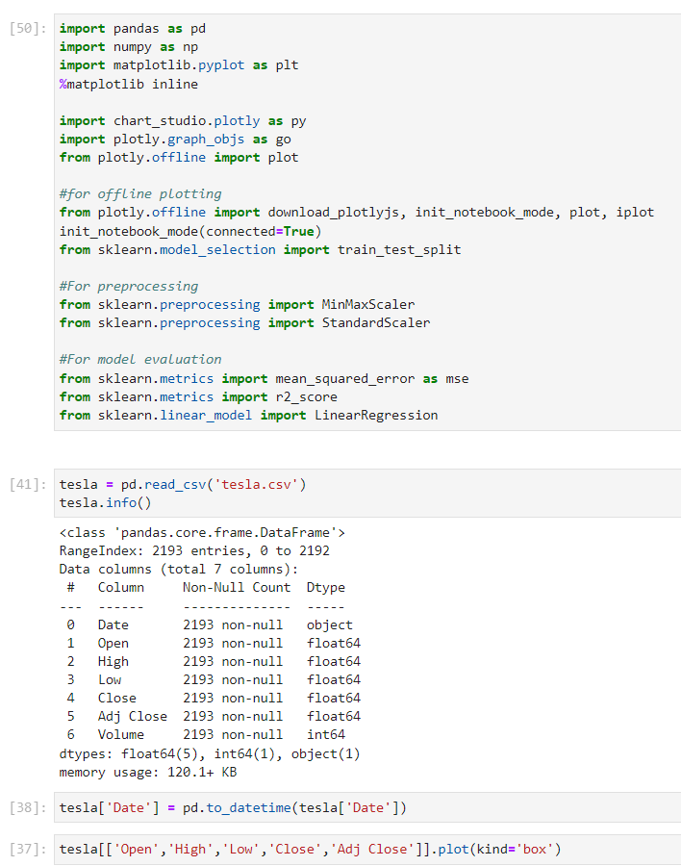
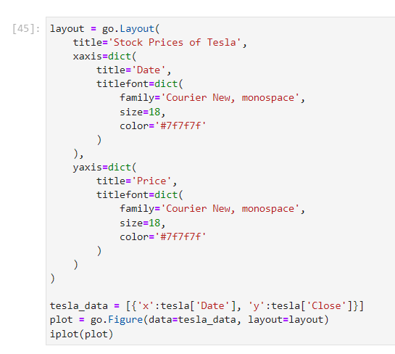
MODULE 1 Implementation

Slide 13
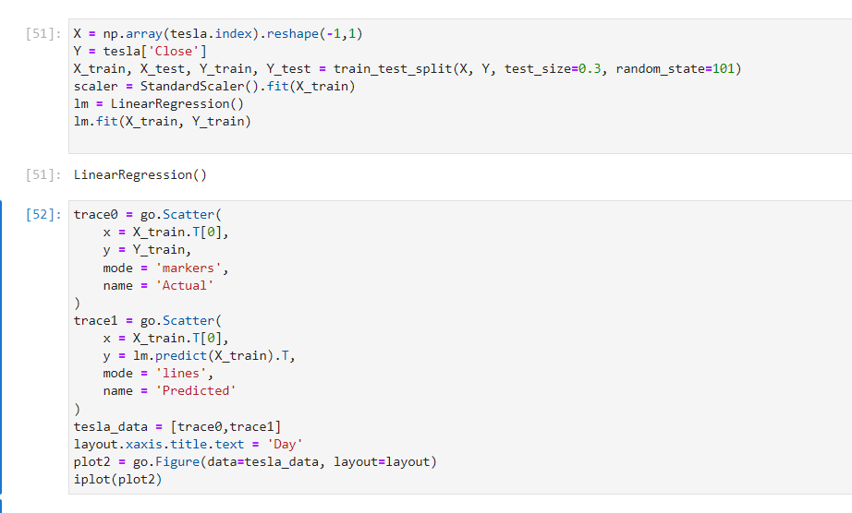
MODULE 1 Implementation

Slide 14
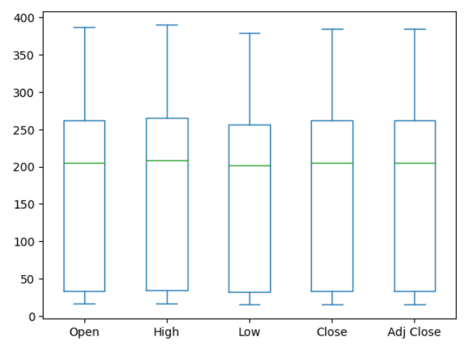
Module 1 Results

Slide 15
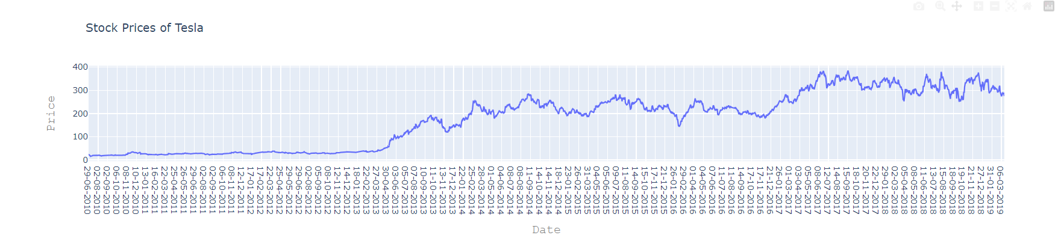
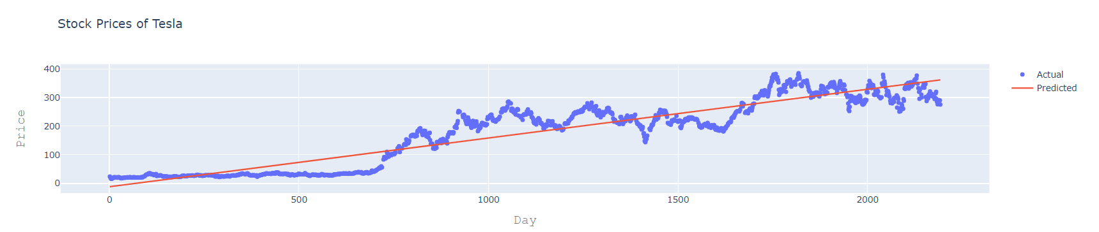
Module 1 Results

Slide 16
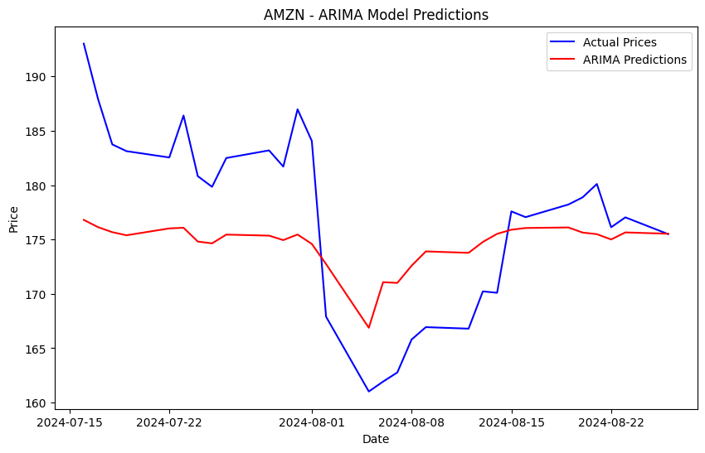
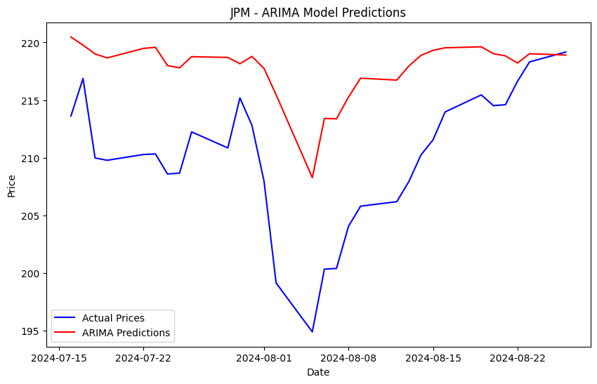
Final Module
AMAZON PREDICTION
JP MORGAN PREDICTION

Slide 17
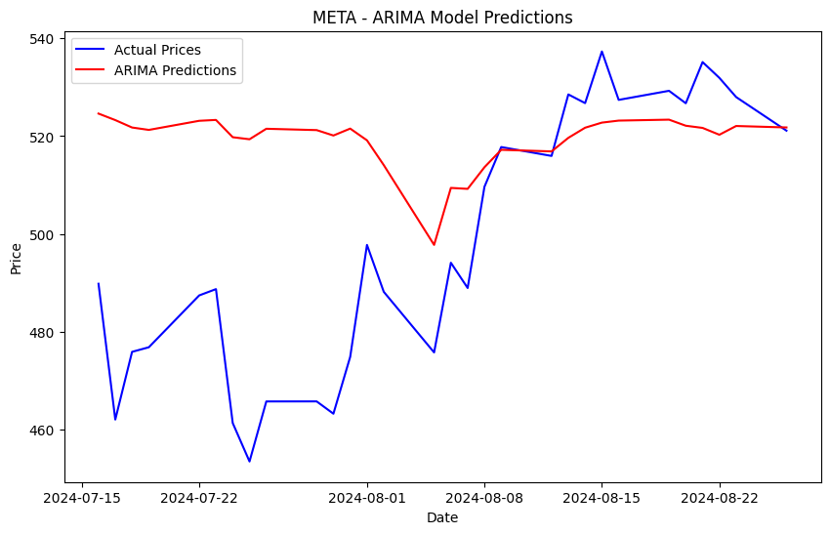
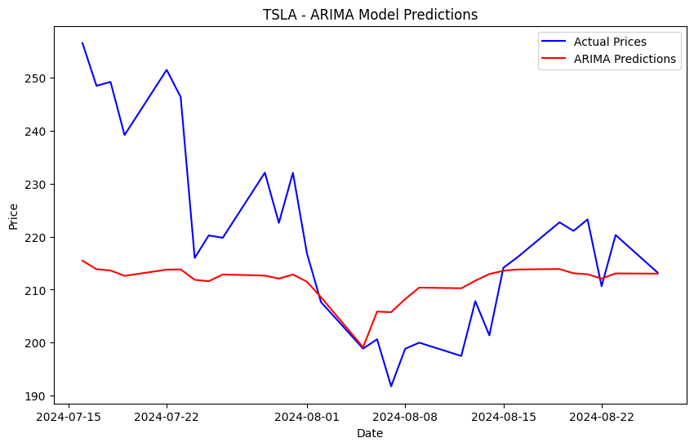
Final Module
META PREDICTION
TESLA PREDICTION

Slide 18
References
"Machine Learning for Financial Market Prediction" by Wenbin Wang et al. (2020) - This paper provides an overview of various machine learning techniques applied to financial markets, including stock prediction models.
"A Comprehensive Review on Machine Learning Techniques and Applications for Stock Market Prediction" by K. K. Patel et al. (2015) - This review covers various machine learning models used for stock market prediction, including time series analysis, neural networks, and ensemble methods.
Published in: 2020 International Conference on Computer Science, Engineering and Applications (ICCSEA)

Slide 19
Outcome
The outcome of a stock prediction model can include predicted future stock prices, the direction of price movement (up or down), or actionable recommendations such as buy, sell, or hold. This algorithm predicts 75% of the stock value precisely for the given stock tickers and the other 30% is decided by the knowledge and experience of the trader. This paper analyses the efficiency of ARIMA and LSTM model which helps the investors to make meaningful conclusions. This model ensures accurate and fast predictions which enables usability and time management factors.

